Slide 1
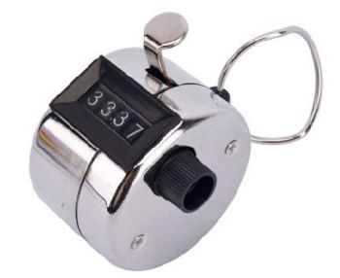
2nd Gen People Counter
By: Mason A. Channer
Notes:
Hello my name is Mason Channer
And the project that I have done was a 2nd Gen People Counter

Slide 2
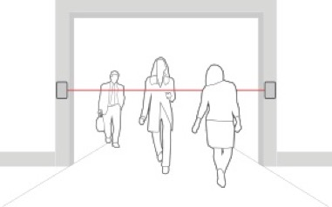
What is a people counter?
A device that counts the number of people who walk through a Narrow passage.

Slide 3
Thermal Sensors
Used in 2nd Gen People counters
HC-SR501 PIR MOTION DETECTOR

Slide 4
Pyroelectric sensor
Electrically charged when heated

Slide 5
Pros
Power efficient
Inexpensive
Detect heated subjects

Slide 6
Cons
Cannot be mounted on a high ceiling
Can only cover a narrow passage
Accuracy of counter is reduced in places with variations in thermal conditions

Slide 7
Challenges
Delay of the Sensor
Soldering
Programming

Slide 12
Technology Used
Software:
C#
Azure
Windows 10 IoT
Hardware:
Raspberry Pi
HC-SR501 PIR Motion Detector
Entity Framework
SQL

